Slide 1
The FT Web App and Automated Testing
Automated testing is good
Jim Cresswell (jim.cresswell@ft.com, @JimCresswell) Developer, FT Labs (@ftlabs)

Slide 2

Notes:
The Financial Times is a newspaper.
It has an average daily global audience across media of more than two million people.

Slide 3

Welcome back to the web
The FT web app provides a touch optimised user experience.
Notes:
The FT has a web app. It used to look like this.

Slide 4

Notes:
And now it looks more like this.
What is a web app? It’s an app that is built with web technologies, if anyone wants to discuss that more let’s leave it until questions.

Slide 5
app.ft.com– same code everywhere.
Notes:
The web app code is cross platform, the same code base powers all the versions of the app.

Slide 6
app.ft.com– same code everywhere
Main platforms
iOS - iPhone and iPad – fullscreen web app
Android - thin native wrapper
Windows 8 – thin HTML5 wrapper
Beta platforms
Most modern mobile and desktop browsers
Notes:
Our main platforms are iOS, Android and Windows 8. However if you type app.ft.com into a browser there is a good chance it will work.

Slide 7
FT Labs labs.ft.com github.com/ftlabs @ftlabs
Notes:
The app is created by FT Labs, a web research and development group within the FT.

Slide 8
FT online numbers
The FT app has over 4 million users [subscribers and anonymous].
“[Digital] subscribers increasing 24% year on year to almost 387,000.”
“Mobile devices now generate 60% of [digital] subscriber consumption, 40% of total traffic and a quarter of new digital subscriptions.”
Notes:
There is free content on ft.com and in the app but it is largely a paid subscription service.
Digital use is being driven by mobile. “Mobile devices” does include a small amount of traffic on m.ft.com but largely“mobile” means “the app”.

Slide 9
How do we stop it from breaking? Testing Testing is good
Notes:
There are lots of types of testing.
There are lots of types of testing I’m not going to talk about, security testing, performance testing, stress testing.
I’m talking here about software quality testing with a particular focus on testing the functionality of the product – is the product doing what it is supposed to do.
How much of what type of testing should we do?

Slide 10
The software testing pyramid
Notes:
A very broad brush answer is “take a look at the software testing pyramid”.

Slide 11
Test Pyramid
Manual
Testing
Functional Testing
Integration Testing
Unit Testing
Notes:
There are plenty of version of this.
The general idea is that you should do more of the faster to execute and cheaper to maintain automated unit testing and less of the slow to execute and quite probably more expensive to maintain manual testing with some amount of automated system-y testing in between.

Slide 12
What happens when you retrofit automated testing to a project?

Slide 13
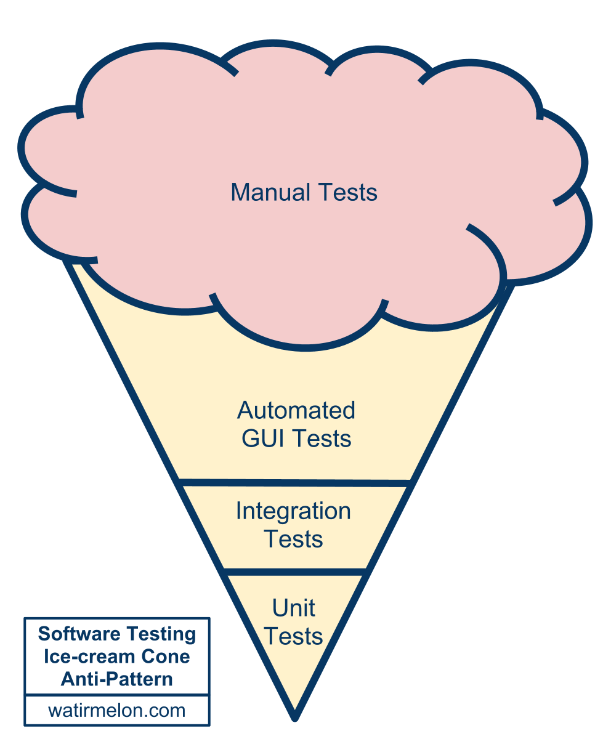
Test Ice-cream
Source:
Alister Scott
http://tiny.cc/testing-pyramid
Notes:
A beautiful cloud of manual testing, with some manual test that have been automated, a few software level tests thrown in their by the enthusiastic and some unit tests written by the rebellious.
A brief note on definitions, currently I think integration tests test behaviours at the code level, unit tests are a tool to aid and speed up software design and mitigate risk in refactors. I may think something else tomorrow.
Somewhat costly to maintain, somewhat slow to run, but a hell of a lot better than no automated tests at all, so if you have reached this point, good work! You can go further.

Slide 14
Where were we 6 months ago?

Slide 15
Where are we today?

Slide 16
What is testing for?

Slide 17
Purple!

Slide 18
Lessons learned

Slide 19
Lessons learned
Make sure everyone is involved, testing and developing are not separate disciplines.

Slide 20
The future…

Slide 21
Summary

Slide 22
Summary
Stuff!

Slide 23
Reading and resources
Open source libraries http://github.com/ftlabs
Tutorials and articles http://labs.ft.com

Slide 24
Thanks!
Jim Cresswell
jim.cresswell@ft.com, @JimCresswell)
Sound like fun?
labs.ft.com/jobs

